Slide 1

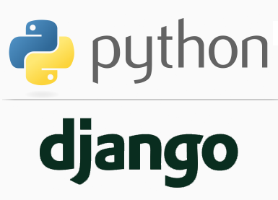
FULL STACK WEB DEVELOPMENT WITH DJANGO
Lecture 2

Slide 2

Today’s Agenda
Understanding Django’s Architecture
Quick Recap Of Django Inroduction
Architecture Of Django
Recap Of MVC
Django’s MVT

Slide 3
What Is Django ?
Django is a free , open source , web application development framework written in Python.
A web application framework is a set of tools which can be used to develop web applications .
These tools help us develop the web application in a faster and easier way.

Slide 4
What Tools Django Provides?
Following are the tools provided by Django that help our web application building easier and rapid:
ORM : For handling database related code
HTML Templating : For generating dynamic HTML
Form Handling : For accepting user inputs
Url Routing : For transferring request to correct web page
User Management : For handling user login/authentication
And many more. . .

Slide 5
What Django Is Not?
Before moving any further , let’s clarify what Django is not or what it does not means .
Django is not a programming language
Python is the programming language
Django is written in Python , but it itself is not a programming language
Django is not a web server
Web server is a software on which we can host our websites or web apps
Django does comes with a web server for testing our apps on local machine but it itself is not a web server.

Slide 6
Django Principles
Apart from giving us some very useful tools to develop a web application , Django also enables us to follow some very popular design principles which are :
Write Good And Clean Code.
Be More Productive With Less Code
To achieve all the above mentioned principles each and every web application we build using Django follows a very important DESIGN PATTERN called MVT which stands for Model –View-Template

Slide 7
Django Architecture
The MVT (Model-View-Template)architecture used by Django is inspired by the famous MVC (Model-View-Controller) architecture used for developing software applications.
So before we can understand Django’s architecure , we must first recall MVC architecture

Slide 8
Understanding MVC
MVC always divides the app into three different parts:
The Model is the logical data structure behind the entire application and is represented by a database(generally relational databases such as MySql, Oracle, Sqlite etc).
The View is the user interface — what you see in your browser when you visit a website. These are represented by HTML/CSS/Javascript files.
The Controller is the middleman that connects the View and Model together, meaning that it is the one passing data from the Model to the View.

Slide 9
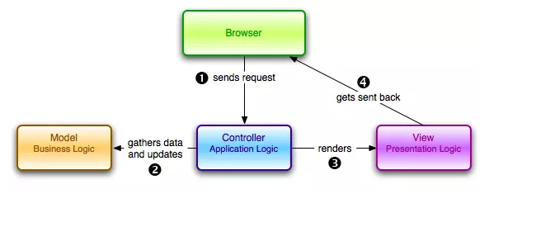
Understanding MVC

Slide 10
Understanding MVC
Here is a rundown of steps involved in an MVC based e-commerce application
Web browser or client sends the request to the web server, asking the server to display books related to Python.
The request received by the server is passed to the controller of the application.
The controller then asks the model to fetch all the Python books from the database..
The model then sends the Python book details to the controller.
The controller then passes these book details to the view.
The view uses book details data to create an HTML page and sends back the response to the client

Slide 11
Understanding Django’s MVT
The Model-View-Template (MVT) is slightly different from MVC.
To understand this difference , let us analyze the role of each component in an MVT based application.

Slide 12
Understanding Django’s MVT
The components of MVT architecture as are follows:
Model - Data access layer.
This deals with access, validation and relationships among data. Models are Python classes that mediate between Django ORM and the database tables.
Template - Presentation layer.
This deals with how data is displayed to the client.
View - Business logic layer.
This is a bridge between models and templates.
A view always accesses model data and redirects it to a template for presentation.
Unlike the definition of a view in traditional MVC architecture, a Django view describes which data you see, not how you see it. It's about processing, not presentation.

Slide 13
Understanding Django’s MVT
Thus in Django , the Model remains same as the regular MVC , but the Views and Controllers are different.
The View in Django plays the role of Controller and Template in Django plays the role of View.

Slide 14
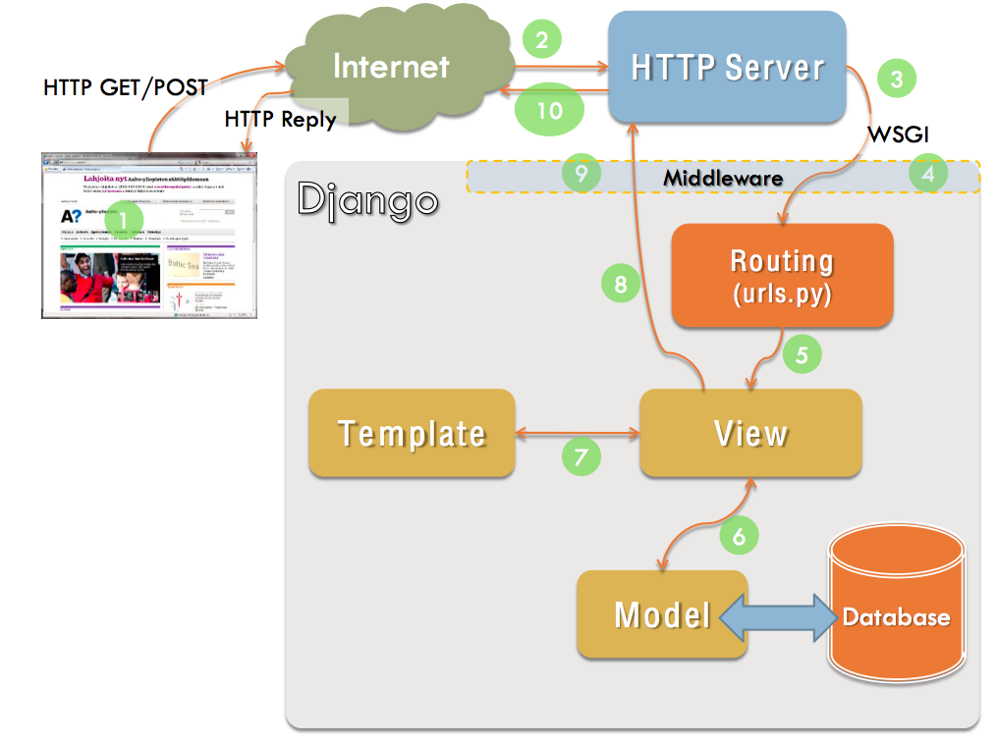
Understanding Django’s MVT

Slide 15
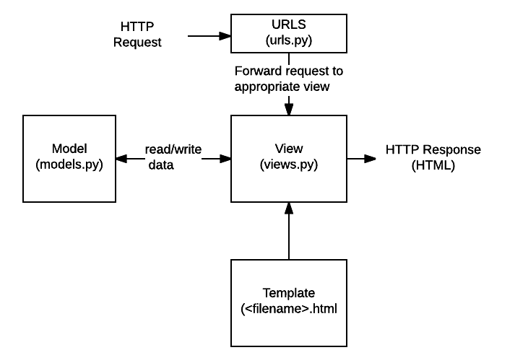
Understanding Django’s MVT

Slide 16
Description Of Each File
URLs: It is called the URL mapper and is used to redirect HTTP requests to the appropriate view , based on the request URL.
View: A view is the request handler function, which receives an HTTP requests and returns HTTP responses. Views can access the data ,needed to satisfy the requests , via models, and delegate the formatting of the response to templates.

Slide 17
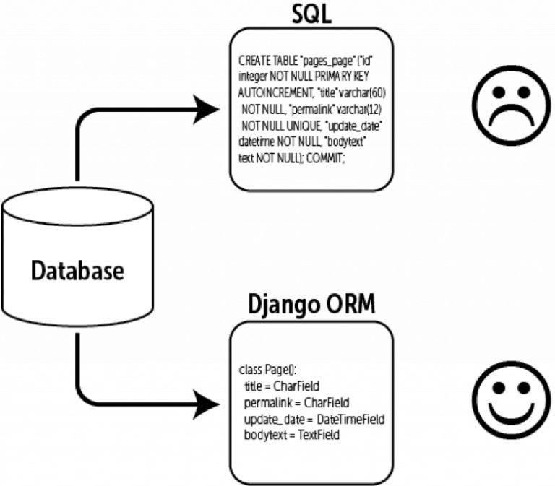
Description Of Each File
Models: Models are Python objects that provide the mechanisms to manage (add, modify, delete and query ) the records in the database. Django’s model makes use of a very powerful ORM layer which simplifies dealing with the database and accelerates the development process.

Slide 18
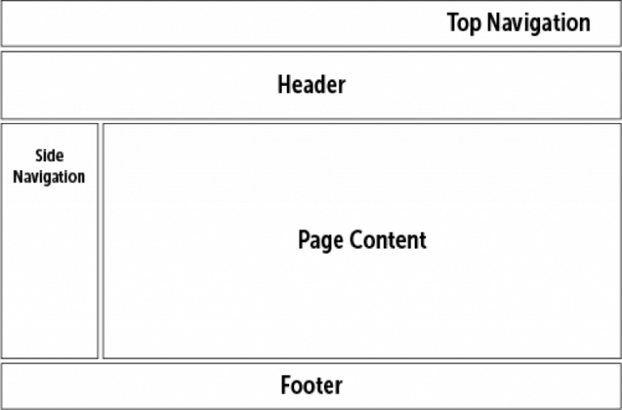
Description Of Each File
Templates: A template is a text file defining the layout of the page (such as an HTML page), with placeholders used to represent actual content. A view can dynamically create an HTML page using an HTML template, populating it with data it pulled from model.

